Slide 1
Operating System
Protection and Security

Slide 2
Protection
Protection in an operating system (OS) refers to the mechanisms and techniques used to safeguard the resources and data of a computer system from unauthorized access and modification.
This is typically achieved through the use of access control mechanisms and permissions, which determine who has the right to access or modify particular resources.

Slide 3
Needs of Protection
There may be security risks like unauthorized reading, writing, modification, or preventing the system from working effectively for authorized users.
It helps to ensure data security, process security, and program security against unauthorized user access or program access.
It is important to ensure no access rights' breaches, no viruses, no unauthorized access to the existing data.

Slide 4
Goals of protection
There may be security risks like unauthorized reading, writing, modification, or preventing the system from working effectively for authorized users.
It helps to ensure data security, process security, and program security against unauthorized user access or program access.
It is important to ensure no access rights' breaches, no viruses, no unauthorized access to the existing data.

Slide 5
Principles of Protection
Principle of least privilege: This principle states that a process or user should only be granted the minimum privileges necessary to perform their intended tasks. This reduces the risk of accidental or malicious damage to the system and limits the scope of any potential security breach.
Separation of privileges: This principle states that critical tasks should be divided among different processes or users, so that no single entity has complete control over the system. This reduces the risk of a single point of failure and makes it harder for an attacker to gain control over the system.

Slide 6
Principles of Protection
Authentication: This principle involves verifying the identity of a user or process before granting access to the system. Authentication typically involves the use of passwords, digital certificates, biometrics, or other methods to confirm the identity of the user.
Authorization: This principle involves determining what resources a user or process is authorized to access, and enforcing access control policies accordingly. Authorization mechanisms may include access control lists, permissions, or other policies that restrict access to specific resources.
Accountability: This principle involves tracking and logging all user and system activities, so that any security breaches or suspicious activities can be detected and investigated. Accountability mechanisms may include audit trails, security logs, or other monitoring tools.

Slide 7
Access Control
Method that determines:
What types of access are permitted on different resources
Under what circumstances
By Whom

Slide 8
Access Control
Access Control Model has 3 basic components:
Subjects (S) or Domain: Represents a finite set of entities that have access to current object.
Subject may be: User , Process or Procedure
Objects (O): Represents a finite set of resources that need access.
Object may be: H/w device ( processor, memory) Or S/W resources ( page table, files etc)
Rights ( R): Represents a finite set of Operations that a Subject can perform on Object.

Slide 9
Access Control Policies
Protection Domain: is a collection of objects and access rights (Permissions –rwx-)
Discretionary Access Control
In this model, Each object is owned by some subject/domain and Owner of the object decides which/ what kind of access rights are there.
Mandatory Access Control
System Administrator enforce a policy for all users.
Role-Based Access Control
Access control is based on roles that users have within the system

Slide 10
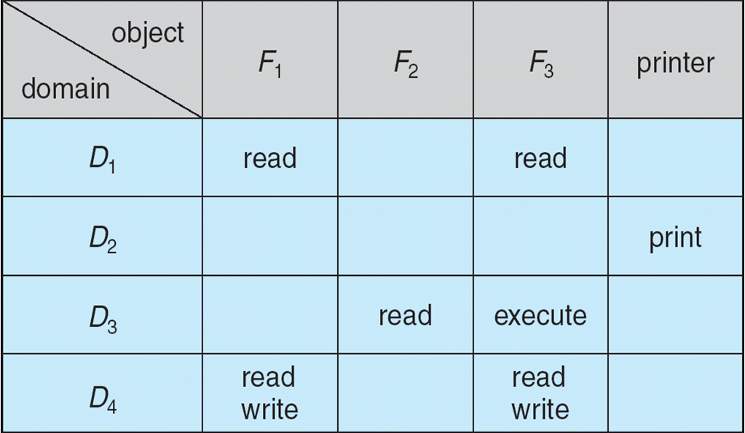
Access Matrix

Slide 11
Use of Access Matrix
If a process in Domain D_{i} tries to do “op” on object O_{j}, then “op” must be in the access matrix Can be expanded to dynamic protection
Operations to add, delete access rights
Special access rights:
owner of O_{i}
copy op from O_{i} to O_{j}
control – D_{i} can modify D_{j} access rights
transfer – switch from domain D_{i} to D_{j}

Slide 12
Implementation of Access Matrix
There are 2 methods:
1. Access Control Lists
ACL can be created by dividing Access Matrix Column Wise.
Separate list is maintained for each domain and each object.
It skips blank row entries in each domain.
2. Capability List
Can be created by dividing Access Matrix Row Wise.
It is list of access rights that a user / domain or a process has for a object.
It is divided into 2 fields:
Object Descriptor
Access Rights

Slide 13
Operation on Access Matrix Entries
1. Copy
It allows the access right to be copied only within the column (for an object)
A process executing in domain D2 can copy read operation into any entry associated with file F2
The ability to copy rights is denoted by an asterisk, indicating that processes in that domain have the right to copy that access within the same column

Slide 14
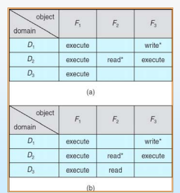
Operation on Access Matrix Entries

Slide 15
Operation on Access Matrix Entries
2. Owner
It allows addition or removal of access rights.
If any access includes owner right then a process executing in domain Di can add or remove any access right in entry of that column.
Copy and Owner allow a process to change the entry in column.

Slide 16
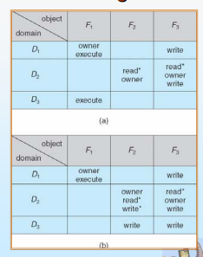
Operation on Access Matrix Entries

Slide 17
Operation on Access Matrix Entries
3. Control Right
Control right mechanism used to change entries in a row.
Control right is applicable only to domain objects.
If access( i , j ) includes control right, then a process executing in domain Di can remove any access right from row j.

Slide 18
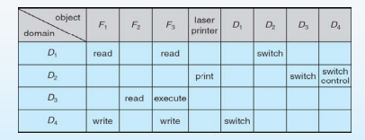
Operation on Access Matrix Entries

Slide 19
Authentication
Process of verifying the identity of user or information
1. User Authentication
Process of verifying the identity of user when user logs into a computer system.
Main Objective: Allow authorized users to access the computer.
Authentication Process consists of 2 steps:
Identification Step
Verification Step

Slide 20
Measures of Authentication
False Acceptance Ratio: % of unauthorized users incorrectly entered the system
False Rejection Ratio: % of authorized users that fails to access the system due to failure of authentication.

Slide 21
General Methods of Authentication
Include a Password
Include electronic key or smart cards
Static Biometric – Recognition by finger print, retina or face.
Dynamic Biometric – Recognition by Voice, Handwriting or Typing Pattern.

Slide 22
i) Active attacks:
An active attack attempts to alter system resources or affect their operations. Active attack involve some modification of the data stream or creation of false statement. Types of active attacks are as following:
1. Masquerade
Masquerade attack takes place when one entity pretends to be a different entity. A Masquerade attack involves one of the other forms of active attacks.
2. Modification of messages
It means that some portion of a message is altered or that message is delayed or reordered to produce an unauthorized effect. For example, a message meaning. Allow JOHN to read confidential file X is modified as Allow Smith to read confidential file X.

Slide 23
Task: Explore attacks and its types

Slide 24
3. Repudiation
This attack is done by either sender or receiver. The sender or receiver can deny later that he/she has send or receive a message. For example, customer asks his Bank.
To transfer an amount to someone and later on the sender (customer) deny that he had made such a request. This is repudiation.
4. Replay
It involves the passive capture of a message and its subsequent transmission to produce an authorized effect.
5. Denial of Service
It prevents normal use of communication facilities. This attack may have a specific target. For example, an entity may suppress all messages directed to a particular destination.
Another form of service denial is the disruption of an entire network wither by disabling the network or by overloading it by messages so as to degrade performance.

Slide 25
Passive Attacks:
A Passive attack attempts to learn or make use of information from the system but does not affect system resources. Passive Attacks are in the nature of eavesdropping on or monitoring of transmission. The goal of the opponent is to obtain information is being transmitted.
Types of Passive attacks are as following:
1. The release of message content
Telephonic conversation, an electronic mail message or a transferred file may contain sensitive or confidential information. We would like to prevent an opponent from learning the contents of these transmissions.
2. Traffic analysis
Suppose that we had a way of masking (encryption) of information, so that the attacker even if captured the message could not extract any information from the message.
The opponent could determine the location and identity of the communicating host and could observe the frequency and length of messages being exchanged. This information might be useful in guessing the nature of the communication that was taking place.
iii)Malware
Malware is malicious software used to breach information systems by exploiting network vulnerabilities. This usually happens when users click links and attachments that install harmful software. There are different types of malware including spyware, ransomware, viruses, and worms. Malware can have a variety of malicious capabilities:
It can block access to the network or parts of the network
It can install other malware
It can secretly copy data from the hard drive and transmit it
It can disrupt the system and make it inoperable
According to the NTT Security 2018 Global Threat Intelligence Report, ransomware attacks increased globally by 350% in 2017 compared to 2016. Its therefore important that organizations prepare for such attacks. Web application penetration testing can identify vulnerabilities within an organizations website before cyber criminals can exploit them.

Slide 26
iv) Phishing
Phishing is a social engineering attack entailing fraudulent communications appearing to come from a trusted source. Attempts to steal sensitive information or trick people into installing malware often come via email. Phishing is the leading cause of cyber-attacks worldwide.
As such, staff must be trained to recognize phishing emails and what to do when they receive one. Our Phishing Staff Awareness Course will prepare your employees to be alert, vigilant, and secure.
v) Man-in-the-middle attack
A MITM (man-in-the-middle) attack is one where the attacker intercepts and relays messages between two parties who believe they are interacting with one another. It is also known as an eavesdropping attack, and once attackers are in the conversation, they can filter, manipulate, and steal sensitive information.
One way to protect your organization from such attacks is to encrypt data. Companies should also put in place auditing and monitoring so that they are kept aware of staff activities. Learn more about how your organization can implement effective information audits.

